Slide 1

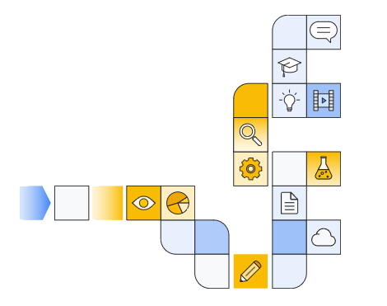

Google cloud Introduction to Vertex AI Studio Part 4

Slide 2
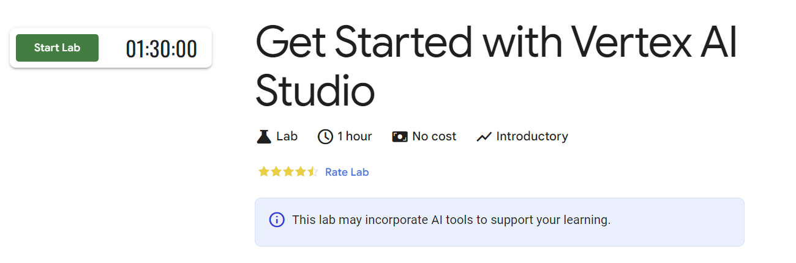
Notes:
https://www.cloudskillsboost.google/focuses/86502

Slide 3


